Slide 1

Web / Mobile Development
Pavan Kumar Jonnadula
Vamsi Alapaty
Priya Varsha Tarlapally
Group - 5

Slide 2
Development Framework
React Native
Android Studio
React first came out as way to build user interfaces for the web using JavaScript.
React Native is flexible and can be used for both Android and IOS.
On the other hand, React Native is detailed as "A framework for building native apps with React.
Java is the framework used.
Android Studio can be used only for Android devices.
Android provides a rich application framework that allows you to build innovative apps and games for mobile devices in a Java language environment.

Slide 3
Introduction
Expo is used to run the application emulator.
To run the Android application:
expo start – android
To Run the IOS application:
expo start -- ios

Slide 4
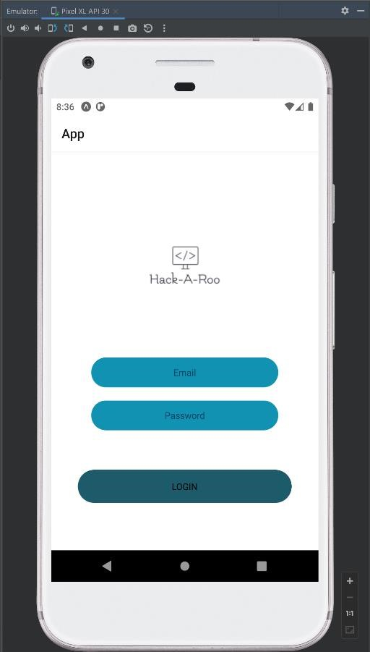
Login Application
Text : The text view has been used for a user to enter the credential details
Touchable Opacity or button: The Login button is a simple way to trigger the Login process on the website or web app
use state: ‘useState()’ is a Hook that allows you to have state variables in functional components.

Slide 5
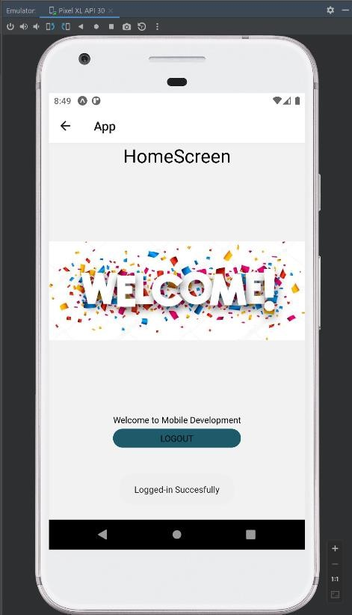
Continue…
Router. Navigate: After a successfully validation the user will be navigated to the home page
Toast: If the validation is no successful, invalid login credentials message would be displayed as a “Toast” message

Slide 6
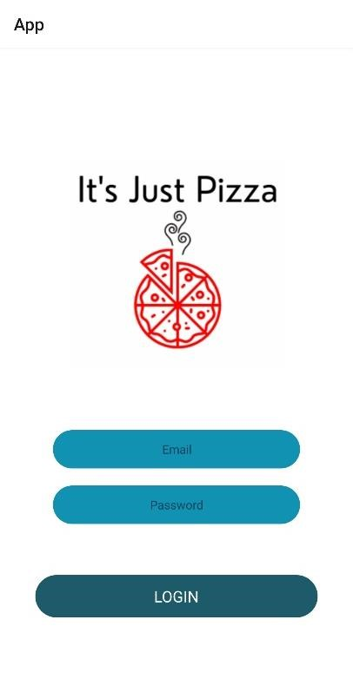
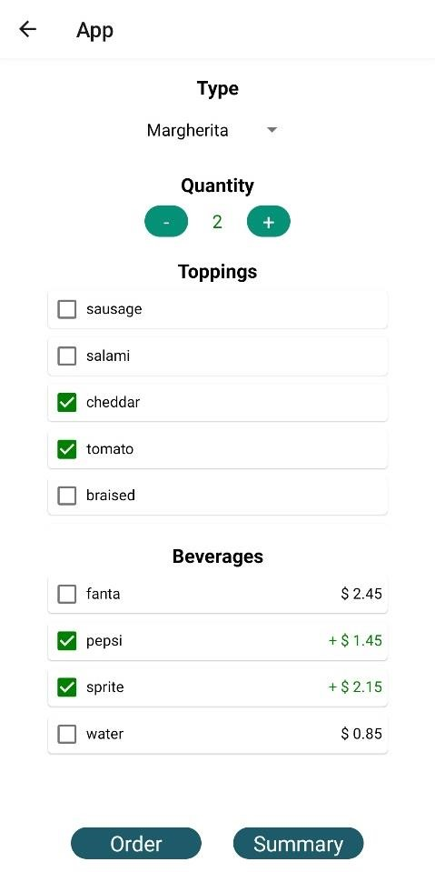
Pizza Ordering App
Post successful login, the user is navigated into ordering screen.
User can select various options to order a pizza.
Different view are used to various options.
Picker for dropdown
Multi-select
Buttons to increment or decrement the count

Slide 7
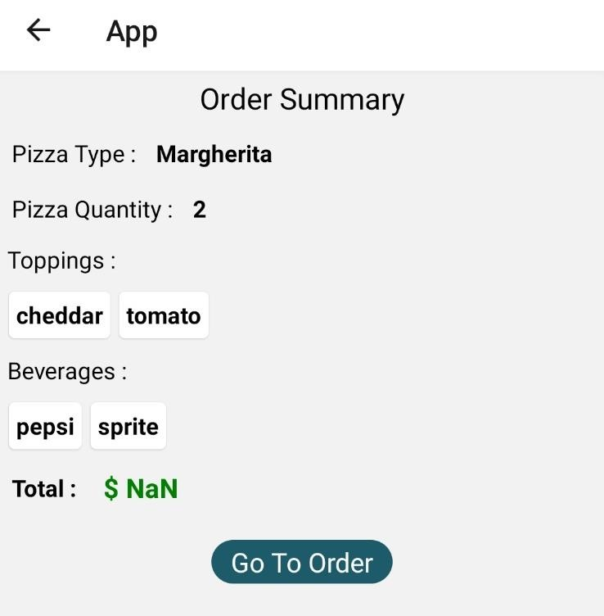
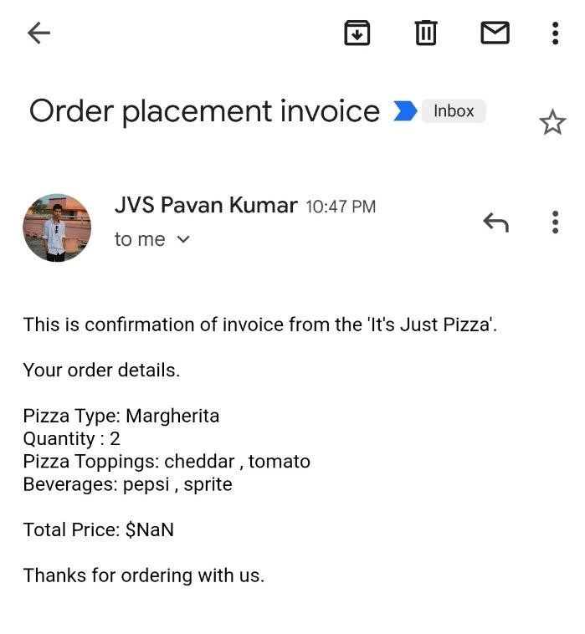
Continue…
In the order summary screen, user can view all the options selected for pizza in a ‘flatList’ view.
Post ordering, the user will be receiving an email confirmation of his order details.
This is achieved by using the ‘Linking’ library of react-native.

Slide 8
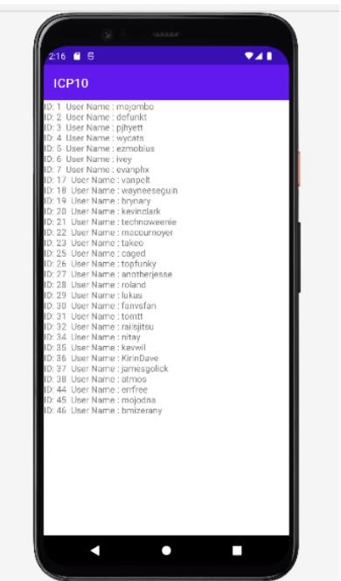
GitHub User App
API integration is done in this application.
An API call is made to get the github users data.
If the API call is successful, the data is displayed using a ‘flatlist’.
If data retrieval is failed, a tost message is displayed saying ‘data failed’.

Slide 9
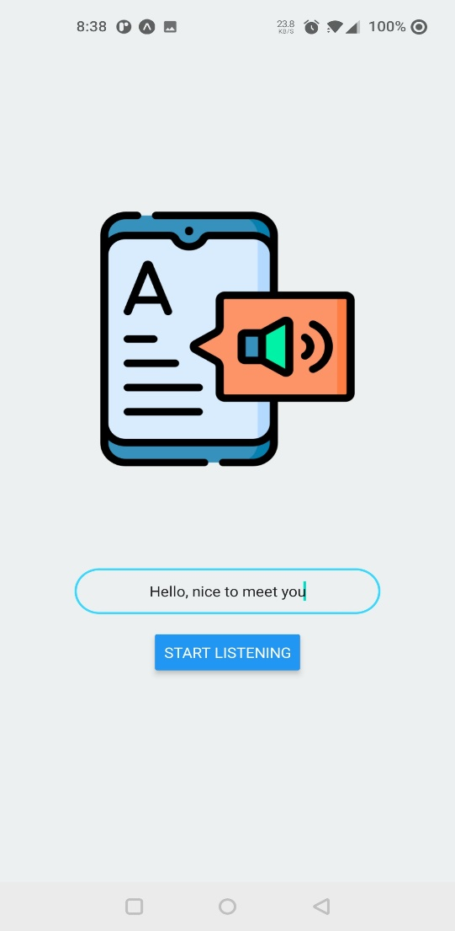
Text to Speech App
This application is used to convert the user entered text into speech.
This is achieved with ‘Speech’ library from the expo-speech package.

Slide 10
Thank you…

